Slide 1

Interpretation & application of recent Immunotherapy for GYN Cancer, based on the experience data in China
Hao Wen
Depart. Gynecological Oncology

Slide 2
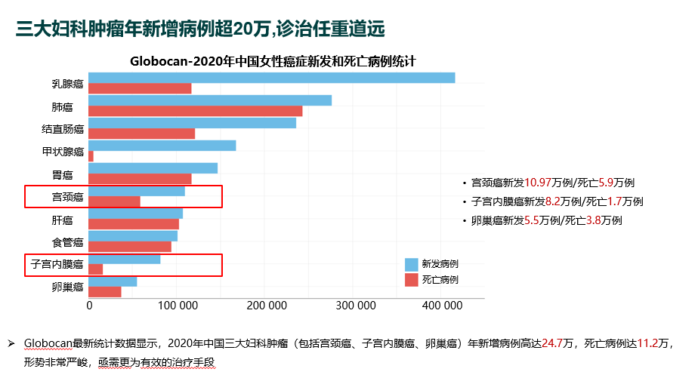
High burden of GYN cancers in China, ＞240,000 new cases per year
Cervical cancer: 109,700 new /59,000 death
Endometrial cancer: 82,000 new /17,000 death
Ovarian cancer: 55,000 new /38,000 death
New cases
Death cases
Globocan’s latest statistics show that in 2020, the new and death cases of three major GYN cancer(including cervical cancer, endometrial cancer and ovarian cancer) were 247,000/112,000 in China. The situation was so severe that more effective treatments were urgently needed
Globocan 2020 statistics.

Slide 3
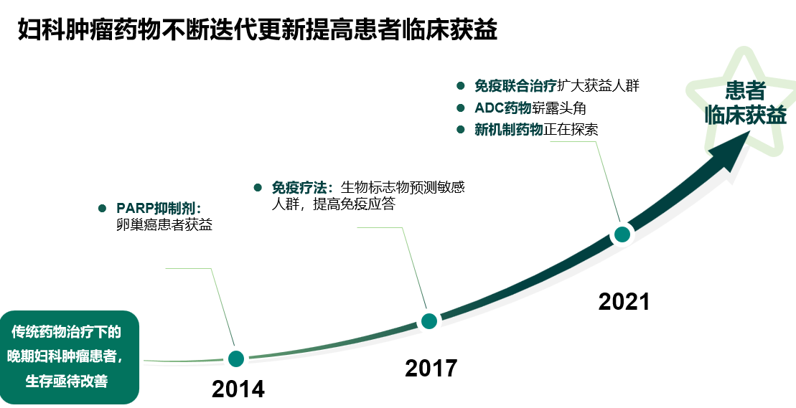
Novel agents(including IO) improve clinical benefits of GYN cancers
IO combinations expand beneficial population
ADC drugs are emerging
Novel mechanism drugs are being explored
Clinical benefits
Immunotherapy: Biomarkers predict sensitive populations, enhancing immune response
PARP inhibitor：
Benefits for OC patients
2021
Survival needs to be improved in patients with advanced GYN cancers treated with traditional medicines
2017
2014

Slide 4
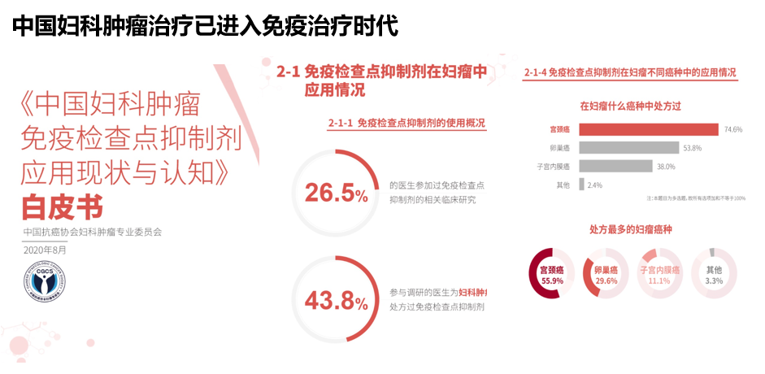



Entering the era of GYN cancer immunotherapy in China
2-1 Application of Immune checkpoint inhibitors in GYN cancer
2-1-4 Application of immune checkpoint inhibitors in different cancer types
Current status and cognition of immune checkpoint inhibitors in GYN cancer in China
Prescription in GYN cancer
2-1-1 Overview of immune checkpoint inhibitors using
Cervical cancer
Ovarian cancer
26.5%
Physicians have participated in relevant clinical studies with immune checkpoint inhibitors
Endometrial
cancer
White Paper
Others
Note: this topic is multi-choice, so the sum of all options is not equal to 100%
C G C S
Aug. 2020
GYN cancer species with most prescriptions
43.8%
Physicians surveyed have prescribed immune checkpoints for GYN cancer patients
Cervicalcancer
55.9%
Ovarian cancer
29.6%
Endometrial
cancer
11.1%
Others
3.3%
《中国妇科肿瘤免疫检查点抑制剂应用现状与认知》白皮书

Slide 5
6、国内自主研发上市免疫药物(11个)：camrelizumab 卡瑞利珠单抗 恒瑞
sintilimab 信迪利单抗 信达
tislelizumab 替雷利珠单抗 百济
toripalimab 特瑞普利单抗 君实
penpulimab 派安普利单抗(AK105)康方
cadonilimab 卡度尼利单抗，研发代号：(AK104)PD-1/CTLA-4双抗 康方
serplulimab 斯鲁利单抗 复宏汉霖
sugemalimab 舒格利单抗 基石(PD-L1单抗)
envafolimab 恩沃利单抗 康宁杰瑞/思路迪 (PD-L1单抗)
zimberelimab 赛帕利单抗 誉衡生物
pucotenlimab 普特利单抗 乐普生物
IO approval & Medical insurance coverage in China
Ipilimumab
Cadonilimab
17 IO products have been approved in China：
11 PD-1 antibodies 4 PD-L1 antibodies
1 Bispecific antibody(PD-1/CTLA4) 1 CTLA4 antibody
Out of these 17 products, 9 PD-1 antibodies, 2 PD-L1 antibodies and 1 Bispecific antibody were domestically developed
Camrelizumab
Envafolimab
Sugemalimab
Atezolizumab
Sintilimab
Pembrolizumab
Durvalumab
Penpulimab
Zimberelimab
Serplulimab
Pucotenlimab
Adebrelimab
Nivolumab
Toripalimab
Tislezumab
2014.9
2014.12
2016.5
2017.3
2017.5
2018.6
2018.7
2018.9
2018.12
2019.5
2019.12
2020.2
2021-2023
Approval data | Drugs | Indications
2021.11 | Envafolimab | For Adults with Unresectable or Metastatic, Microsatellite Instability-High (MSI-H) or Mismatch Repair Deficient (dMMR) solid cancer.
2022.3 | Tislezumab
2022.3 | Serplulimab
2022.7 | Pucotenlimab
2023.7 | Zimberelimab | For patients with PD-L1 positive, recurrent or metastatic cervical cancer who have failed to receive platinum-containing chemotherapy
2023.Q4 | Pembrolizumab | For Adults with Unresectable or Metastatic, MSI-H or dMMR solid cancer.
2022.6 | Cadonilimab | For patients with recurrent or metastatic cervical cancer who have failed to receive platinum-containing chemotherapy
Covered by NRDL
Non-domestically developed PD-1 antibody | Non-domestically developed PD-L1 antibody | Non-domestically developed CTLA-4 antibody | Domestically developed PD-1 antibody | Domestically developed PD-L1 antibody | Domestically developed Bispecific antibody

Slide 6
Cervical Cancer: Breakthrough in all lines
  LACC
  1L CC
  ≥2L CC
  Endometrial Cancer: Precision and IO combinations
  Newly diagnosed EC
  FPST(following prior systemic therapy) EC
  Ovarian Cancer: IO combinations
  1L maintenance OC
  PROC
Contents
LACC, locally advanced cervical cancer

Slide 7
IO landscape in CC in China
Drug | LACC | 1L R/M CC | ≥2L R/M CC
pembrolizumab | Ph3 KN-A18(Pembro+CCRT) | Ph3 KEYNOTE-826(Pembro+Chemo±Bev) | Ph2 KEYNOTE 158(Pembro alone)
Cadonilimab | Ongoing:Ph3 AK104-305(AK-104+CCRT) | Ph2 AK104-210(AK-104+Chemo±Bev) Ongoing:Ph3 AK104-303(AK-104+Chemo±Bev) | Ph2 AK104-201(AK-104 alone)
Camrelizumab | Ph2 NACI (Camrelizumab+Chemo as NACIT) | Ongoing:Ph3 NCT04906993 (Camrelizumab+Famitinib) | Ph2 NCT03827837 (Camrelizumab＋Famitinib) Ph2 CLAP(Camrelizumab＋Apatinib)
Tislelizumab | Ongoing:Ph2 NCT05588219 (Tislelizumab+Chemo) | Ph2 NCTO5247619 (Tislelizumab＋Chemo+Bev) Ongoing:Ph2 NCT05310383 (Tislelizumab+RT) | Ph2 (Tislelizumab+Anlotinib) Ongoing:Ph2 AdvanTIG-202 (Tislelizumab±Ociperlimab)
Toripalimab | ChiCTR2000032879(Toripalimab+CCRT) | Ph2 NCT04973904(Toripalimab＋Chemo+Bev) | -
Zimberelimab | - | - | Ph2 NCT03972722 (Zimberelimab)
Serplulimab | - | - | Ph2 NCT04150575 (Serplulimab+Nab-paclitaxel)
Sintilimab | - | - | Ph2 (Sintilimab+Anlotinib)
https://classic.clinicaltrials.gov/ct2/show/NCT04221945
Jing Chen, et al. 2023 ASCO No.5520.
2022 ASCO Abs 5538.
Monk B, et al. 2023 ASCO, abstract 5500.
2022 ASCO 106
2023 ASCO 5531
Peng Peng, et al. 2023 SGO Oral 211
Maio M, et al. Ann Oncol. 2022;33(9):929-938
2022 SGO AK104-201(NCT04380805)
2022 ESMO IO Abs 79P.
Min Zheng et al.2022 ESMO 564P
An J, Li X, Wang J, et al. Front Immunol. 2023;14:1142256.
Xia L, et al. Nat Commun. 2022;13(1)_7581.
Chunyan Lan et al. 2023 ASCO e17513.
Xu Q, et al. J Clin Oncol. 2022;40(16):1795-1805
https://classic.clinicaltrials.gov/ct2/show/NCT04982237
https://classic.clinicaltrials.gov/ct2/show/NCT05235516
https://classic.clinicaltrials.gov/ct2/show/NCT05310383
https://classic.clinicaltrials.gov/ct2/show/NCT05588219
https://classic.clinicaltrials.gov/ct2/show/NCT04693234
https://classic.clinicaltrials.gov/ct2/show/NCT04906993

Slide 8



IO trials with results in LACC
Drugs | Pembrolizumab | Camrelizumab | Toripalimab
Company
MoA | Anti-PD-1 | Anti-PD-1 | Anti-PD-1
Patients | LACC | LACC | LACC
Treatment | Pembrolizumab + CCRT | Camrelizumab + Chemo as neoadj treatment | Toripalimab + CCRT
Study | KEYNOTE-A18 | NACI | ChiCTR2000032879
Phase | III | II | -
Approval in China | - | - | -
Primary Endpoint | PFS;OS | ORR | Safety and Feasibility
https://classic.clinicaltrials.gov/ct2/show/NCT04221945
Jing Chen, et al. 2023 ASCO No.5520.
2022 ASCO Abs 5538.

Slide 9
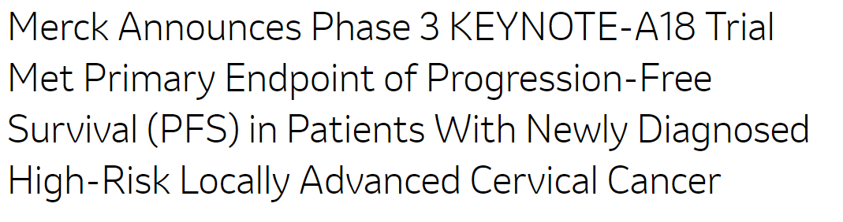
Pembrolizumab + CCRT in high-risk LACC met the primary endpoint of PFS
KEYNOTE-A18：Chemoradiotherapy With or Without Pembrolizumab
Study design
Eligibility Criteria(N)
Has high-risk LACC (LACC)：FIGO 2014 Stage IB2-IIB (with node-positive disease) or FIGO 2014 Stages III-IVA
Has not previously received any definitive surgical, radiation, or systemic therapy for cervical cancer, including investigational agents, and is immunotherapy-naïve
ECOG PS 0–1
5 cycles
15 cycles
July 19, 2023，MSD announced that the Phase 3 KEYNOTE-A18 trial met one of its primary endpoints of PFS
An interim analysis showed a statistically significant and clinically meaningful improvement in PFS versus concurrent chemoradiotherapy alone and a favorable trend in OS, however, these OS data were not mature
The safety profile of KEYTRUDA in this trial was consistent with that observed in previously reported studies; no new safety signals were identified
Pembrolizumab
200 mg IV Q3W +chemoradio-therapy
Pembrolizumab
400 mg IV Q6W
Primary Outcome
R 1:1
PFS
OS
Placebo Q3W +chemoradio-therapy
Placebo Q6W
Differences between KEYNOTE-A18 and CALLA:
Eligibility(eg, size and number of lymph nodes)
Study Design (KEYNOTE-A18 used PFS and OS endpoints as primary endpoints)
Choice of chemotherapeutic agents (cisplatin or carboplatin for CALLA study, cisplatin for KEYNOTE-A18)
The positive results obtained in the KEYNOTE-A18 study mark the entry of LACC into the era of immunotherapy
https://classic.clinicaltrials.gov/ct2/show/NCT04221945
https://www.businesswire.com/news/home/20230719399142/en/Merck-Announces-Phase-3-KEYNOTE-A18-Trial-Met-Primary-Endpoint-of-Progression-Free-Survival-PFS-in-Patients-With-Newly-Diagnosed-High-Risk-Locally-Advanced-Cervical-Cancer/

Slide 10
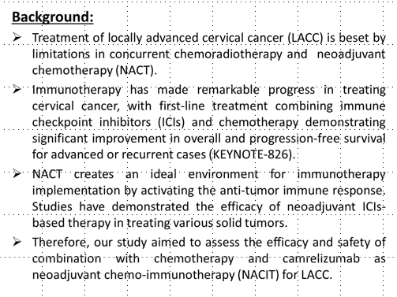
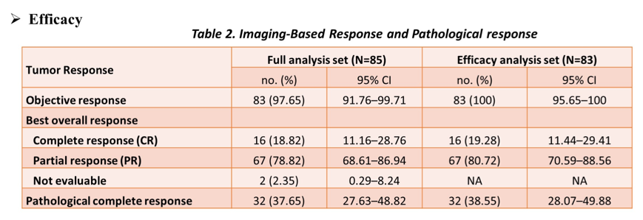
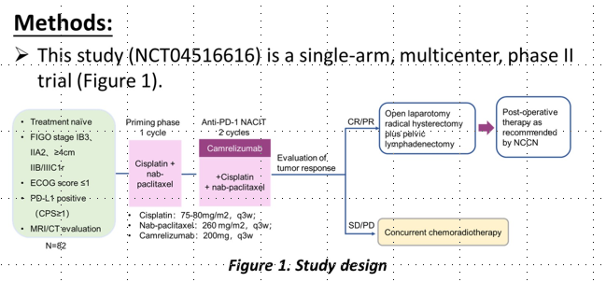
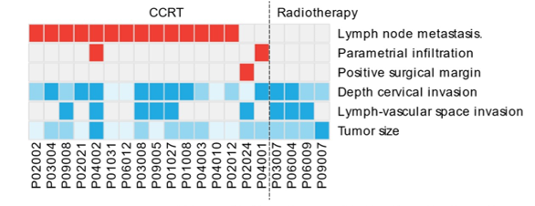
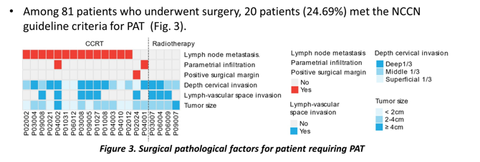
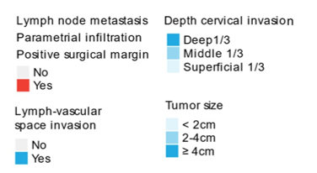
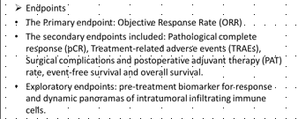
NACI: Camrelizumab + chemotherapy as NACIT for LACC resulted in ORR 100%, CR 19.28%, and pCR 38.55%
NACI(NCT04516616) is a single-arm, multicenter, phase ll trial. This study aimed to assess the efficacy and safety of chemotherapy + camrelizumab as NACIT for LACC.
Priming phase
1 cycle
Anti-PD-1 NACIT
2 cycles
Open laparotomy radical hysterectomy plus pelvic lymphadenectomy
Post-operative therapy as recommended by NCCN
Treatment naïve
FIGO stage IB3、lIA2、≥4cm lIB/IIIC1r
ECOG score ≤1
PD-L1 positive(CPS≥1)
MRI/CT evaluation
CR/PR
Evaluation
of tumor response
Primary endpoint
ORR
Secondary endpoints
pCR,TRAEs
Cisplatin+nab-paclitaxel
Camrelizumab
+Cisplatin
+nab-paclitaxel
Cisplatin：75-80 mg/m²，q3w
Nab-paclitaxel：260 mg/m²，q3w
Camrelizumab：200 mg，q3w
Concurrent chemoradiotherapy
SD/PD
lmaging-Based Response and Pathological response
Among 81 patients who underwent surgery, 20 patients (24.69%) met the NCCN guideline criteria for PAT
Tumor Response | Full analysis set (N=85) |  | Efficacy analysis set (N=83)
 | No.(%) | 95%CI | No.(%) | 95%CI
Objective response | 83(97.65) | 91.76-99.71 | 83(100) | 95.65-100
Best overall response
CR | 16(18.82) | 11.16-28.76 | 16(19.28) | 11.44-29.41
PR | 67(78.82) | 68.61-86.94 | 67(80.72) | 70.59-88.56
Not evaluable | 2(2.35) | 0.29-8.24 | NA | NA
Pathological complete response | 32(37.65) | 27.63-48.82 | 32(38.55) | 28.07-49.88
N=82
Surgical pathological factors for patient requiring PAT
NACIT, neoadjuvant chemo-immunotherapy
Jing Chen, et al. 2023 ASCO No.5520.

Slide 11
Toripalimab + CCRT for patients with LACC resulted in ORR 100%, PFS rate 90.1%, OS rate 95.5%
ChiCTR2000032879 Study design
Eligible patients(N=22)
LACC
regardless of programmed death ligand-1 status
Endpoint
Concurrent chemoradiotherapy(CCRT) includes :
cisplatin (40mg/m², once a week for 5 weeks)
radiotherapy (external irradiation 45-50.4Gy/25-28Fx, 5 fractions a week
followed by brachy-therapy 24-30Gy/3-5Fx) and toripalimab (240mg on days 1, 22 and 43).
Primary endpoint
safety and feasibility
Secondary endpoint
PFS
ORR
OS
Results (DCO:Jan 31, 2022)
Conclusions:
Toripalimab combined with concurrent chemoradiotherapy demonstrated a manageable safety profile and promising anti-tumor activity in patients with LACC, thus might represent a novel treatment option for this patient population. Longer follow-up results and further phase II/III studies are expected.
All patients have received CCRT successfully
Grade III and higher adverse events (AEs) were observed in 10 patients (10/22, 45.5%)
No patient had a grade V AE
The 3-month ORR rate was 95.5%
The ORR was 100%, while the PFS rate was 90.1%, and the OS rate was 95.5%
2022 ASCO Abs 5538.

Slide 12


IO trials with results in 1L R/M CC
Drugs | Pembrolizumab | Cadonilimab | Tislelizumab | Toripalimab
Company
MoA | Anti-PD-1 | Anti-PD-1/CTLA-4 | Anti-PD-1 | Anti-PD-1
Patients | 1L R/M CC | 1L R/M CC | 1L R/M CC | 1L R/M CC
Treatment | Pembrolizumab + Chemo ± Bevacizumab | Cadonilimab + Chemo ± Bevacizumab | Tislelizumab ＋Chemo + Bevacizumab | Toripalimab ＋Chemo + Bevacizumab
Study | KEYNOTE-826 | AK104-210 | NCTO5247619 | NCT04973904
Phase | III | II | II | II
Approval in China | - | - | - | -
Primary Endpoint | PFS;OS | Safety | PFS | ORR
1L, first-line; R/M CC, Recurrent/Metastatic cervical cancer
Monk B, et al. 2023 ASCO, abstract 5500.
2022 ASCO 106
2023 ASCO 5531
Peng Peng, et al. 2023 SGO Oral 211

Slide 13
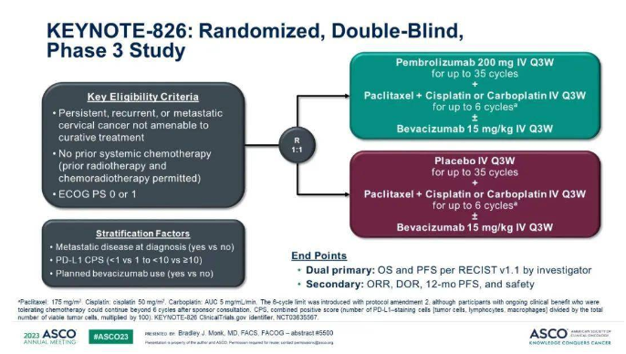
KEYNOTE-826: Randomized, Double-Blind, Phase 3 Study
Pembrolizumab 200 mg lV Q3W
for up to 35 cycles +
Paclitaxel+ Cisplatin or Carboplatin lV Q3W
for up to 6 cyclesª
±Bevacizumab 15 mglkg lV Q3W
Key Eligibility Criteria：
Persistent,recurrent, or metastatic cervical cancer not amenable to curative treatment
No prior systemic chemotherapy(prior radiotherapy and chemoradiotherapy permitted)
ECOG PS 0 or 1
R
1:1
Placebo lV Q3W
for up to 35 cycles
Paclitaxel+ Cisplatin or Carboplatin lV Q3W
for up to 6 cyclesª
±Bevacizumab 15 mg/kg IV Q3W
Stratification Factors
Metastatic disease at diagnosis (yes vs no)
PD-L1 CPS(<1 vs 1 to<10 vs ≥10)
Planned bevacizumab use (yes vs no)
Dual primary: OS and PFS per RECISTv1.1 by investigator.
Secondary: ORR,DOR,12-mo PFS, and safety
ªPaclitaxel: 175 mg/m².Cisplatin: cisplatin 50 mg/m².Carboplatin: AUC 5 mg/mL/min. The 6-cycle limit was introduced with protocol amendment 2, although participants with ongoing clinical benefit who were tolerating chemotherapy could continue beyond 6 cycles after sponsor consultation.
Monk B, et al. 2023 ASCO, abstract 5500.

Slide 14
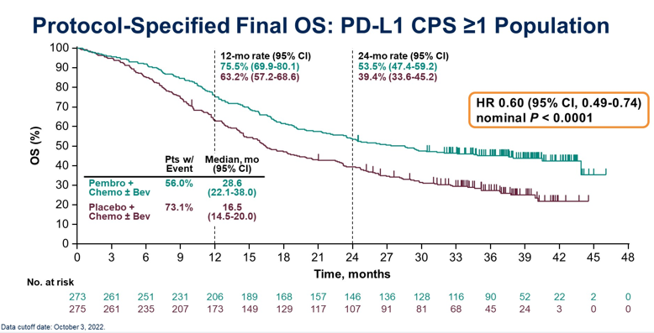
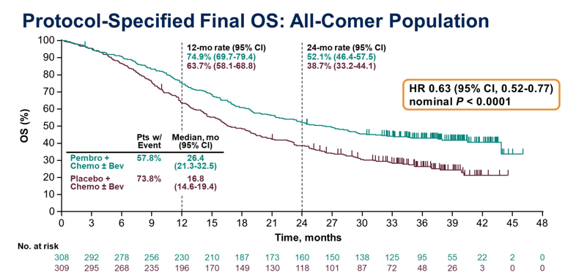
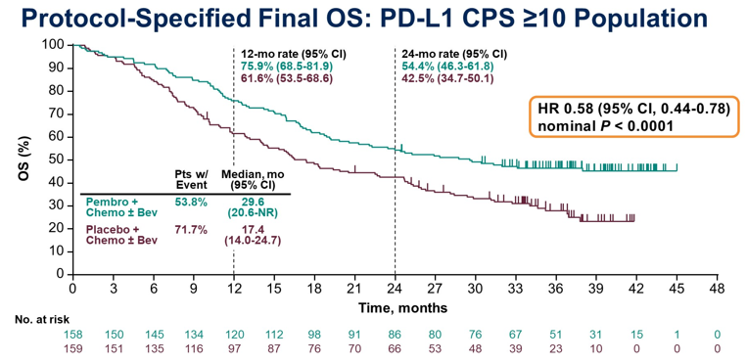
Pembrolizumab + chemotherapy ± bevacizumab has become the SOC for 1L R/M CC
Benefit observed in all protocol-specified primary analysis populations:
OS: PD-L1 CPS ≥1 (HR 0.60), all-comer (HR 0.63), and CPS ≥10(HR 0.58)
PFS: PD-L1 CPS ≥1 (HR 0.58), all-comer(HR 0.61), and CPS ≥10(HR 0.52)
ORR was higher and DOR was longer with the addition of pembrolizumab
Safety profile for pembrolizumab + chemotherapy ± bevacizumab was manageable
Findings are consistent with the previous interim data and provide further support for
Pembrolizumab + chemotherapy ± bevacizumab, as a new SOC for women with persistent, 1L R/M CC
Monk B, et al. 2023 ASCO, abstract 5500.

Slide 15
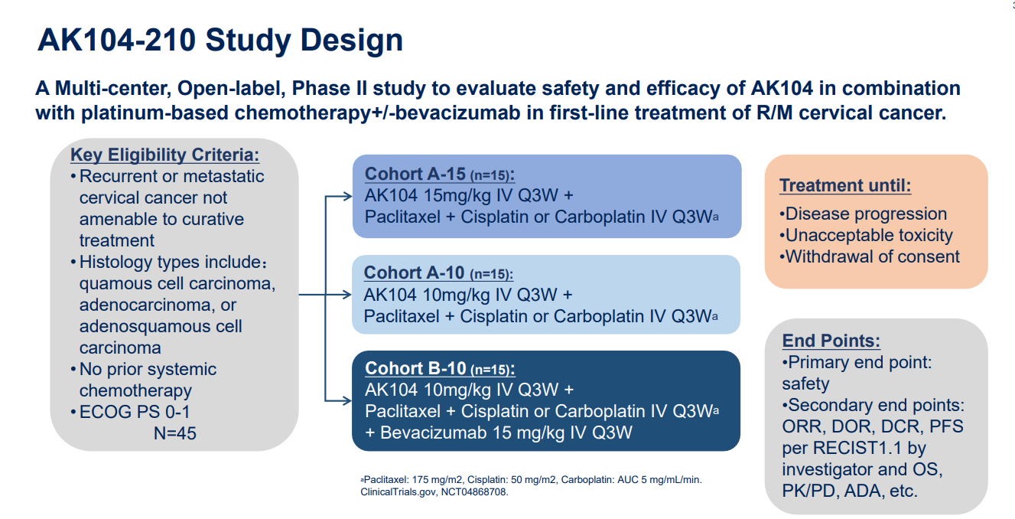
AK104-210: AK104 + chemotherapy ± bevacizumab for 1L R/M CC
A Multi-center, Open-label, Phase II study to evaluate safety and efficacy of AK104 in combination with platinum-based chemotherapy+/-bevacizumab in 1L treatment of R/M cervical cancer.
Key Eligibility Criteria:
Recurrent or metastatic cervical cancer not amenable to curative treatment
Histology types include:quamous cell carcinoma, adenocarcinoma, or adenosquamous cell Carcinoma
No prior systemic Chemotherapy
ECOG PS 0-1
N=45
Cohort A-15 (n=15):
AK104 15mg/kg IV Q3W +
Paclitaxel + Cisplatin or Carboplatin IV Q3Wª
End Points:
Primary end point: safety
Secondary end points: ORR, DOR, DCR, PFS per RECIST1.1 by investigator and OS, PK/PD, ADA, etc.
Treatment until:
Disease progression
Unacceptable toxicity
Withdrawal of consent
Cohort A-10 (n=15):
AK104 10mg/kg IV Q3W +
Paclitaxel + Cisplatin or Carboplatin IV Q3Wª
Cohort B-10 (n=15):
AK104 10mg/kg IV Q3W +
Paclitaxel + Cisplatin or Carboplatin IV Q3Wª
+ Bevacizumab 15 mg/kg IV Q3W
ªPaclitaxel: 175 mg/m², Cisplatin: 50 mg/m², Carboplatin: AUC 5 mg/mL/min.
ClinicalTrials.gov, NCT04868708.
2022 ASCO 106

Slide 16
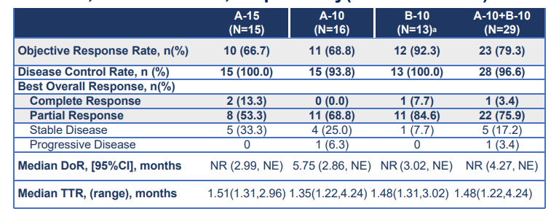
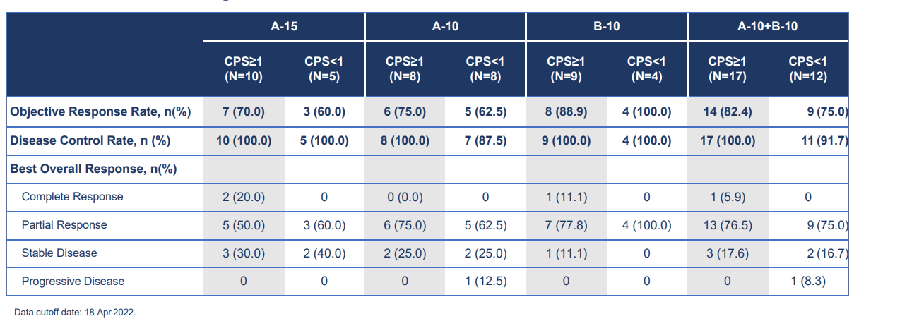
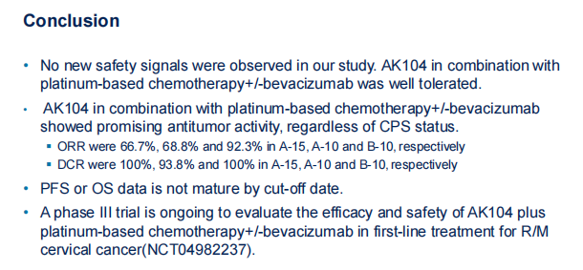
AK104 + chemotherapy ± bevacizumab for 1L R/M CC resulted in ORR 66.7%, 68.8% and 92.3% in A-15, A-10 and B-10,respectively
 | A-15 (N=15) | A-10 (N=16) | B-10 (N=13)ª | A-10+B-10 (N=29)
Objective Response Rate, n(%) | 10 (66.7) | 11 (68.8) | 12 (92.3) | 23 (79.3)
Disease Control Rate, n (%) | 15 (100.0) | 15 (93.8) | 13 (100.0) | 28 (96.6)
Best Overall Response, n(%)
Complete Response | 2 (13.3) | 0 (0.0) | 1 (7.7) | 1 (3.4)
Partial Response | 8 (53.3) | 11 (68.8) | 11 (84.6) | 22 (75.9)
Stable Disease | 5 (33.3) | 4 (25.0) | 1 (7.7) | 5 (17.2)
Progressive Disease | 0 | 1 (6.3) | 0 | 1 (3.4)
Median DoR, [95%CI], months NR (2.99, NE) 5.75 (2.86, NE) NR (3.02, NE) NR (4.27, NE)
Median TTR, (range), months 1.51(1.31,2.96) 1.35(1.22,4.24) 1.48(1.31,3.02) 1.48(1.22,4.24)
 | A-15 |  | A-10 |  | B-10 |  | A-10+B-10
 | CPS≥1 (N=10) | CPS<1 (N=5) | CPS≥1 (N=8) | CPS<1 (N=8) | CPS≥1 (N=9) | CPS<1 (N=4) | CPS≥1 (N=17) | CPS<1 (N=12)
Objective Response Rate, n(%) | 7 (70.0) | 3 (60.0) | 6 (75.0) | 5 (62.5) | 8 (88.9) | 4 (100.0) | 14 (82.4) | 9 (75.0)
Disease Control Rate, n (%) | 10 (100.0) | 5 (100.0) | 8 (100.0) | 7 (87.5) | 9 (100.0) | 4 (100.0) | 17 (100.0) | 11 (91.7)
Best Overall Response, n(%)
Complete Response | 2 (20.0) | 0 | 0 (0.0) | 0 | 1 (11.1) | 0 | 1 (5.9) | 0
Partial Response | 5 (50.0) | 3 (60.0) | 6 (75.0) | 5 (62.5) | 7 (77.8) | 4 (100.0) | 13 (76.5) | 9 (75.0)
Stable Disease | 3 (30.0) | 2 (40.0) | 2 (25.0) | 2 (25.0) | 1 (11.1) | 0 | 3 (17.6) | 2 (16.7)
Progressive Disease | 0 | 0 | 0 | 1 (12.5) | 0 | 0 | 0 | 1 (8.3)
Data cut off date: 18 Apr 2022
Conclusions
AK104 in combination with platinum-based chemotherapy+/-bevacizumab was well tolerated.
AK104 in combination with platinum-based chemotherapy+/-bevacizumab showed promising antitumor activity, regardless of CPS status.
ORR were 66.7%, 68.8% and 92.3% in A-15, A-10 and B-10,respectively
DCR were 100%, 93.8% and 100% in A-15, A-10 and B-10,respectively
PFS or OS data is not mature by cut-off date.
2022 ASCO 106

Slide 17
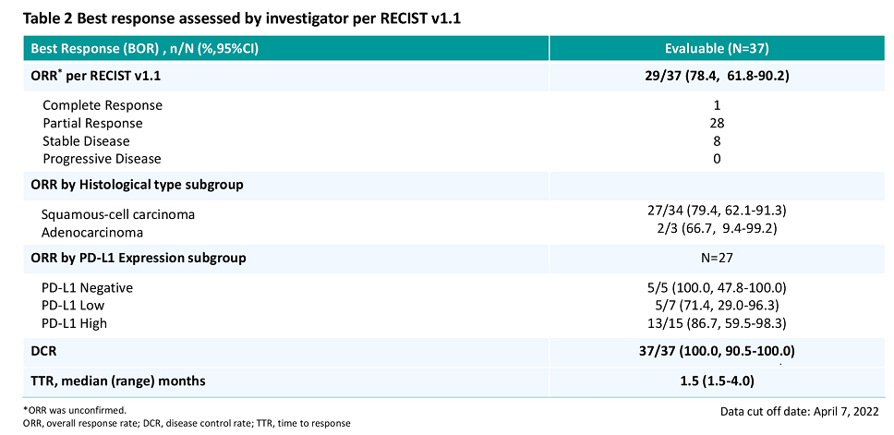
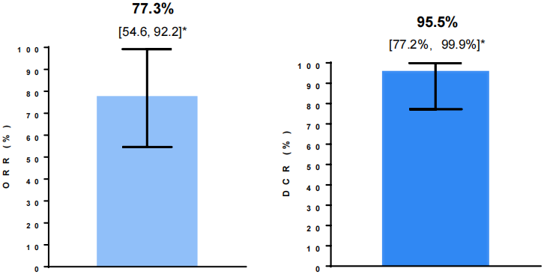
Toripalimab or Tislelizumab + Chemotherapy + Bevacizumab for 1L R/M CC resulted in ORR 77.3% and 78.4%, respectively
This study(NCTO5247619) aimed to investigate the efficacy and safety of toripalimab combined with bevacizumab and platinum-based chemotherapy for the 1L treatment of refractory, R/M CC
This study(NCTO5247619) comprising two parts of safety run-in and cohort expansion. Patients with persistent, R/M CC were enrolled and received tislelizumab+bevacizumab+cisplatin or carboplatin+paclitaxel
Investigator-Assessed ORR
Best response assessed by investigator per RECIST v1.1
Best Response (BOR) , n/N (%,95%CI) | Evaluable (N=37)
ORR* per RECIST v1.1 | 29/37(78.4，61.8-90.2)
Complete Response | 1
Partial Response | 28
Stable Disease | 8
Progressive Disease | 0
ORR by Histological type subgroup
Squamous-cell carcinoma | 27/34(79.4,62.1-91.3)
Adenocarcinoma | 2/3(66.7,9.4-99.2)
ORR by PD-L1 Expression subgroup | N=27
PD-L1 Negative | 5/5(100.0,47.8-100.0)
PD-L1 Low | 5/7(71.4. 29.0-96.3)
PD-L1 High | 13/15(86.7,59.5-98.3)
DCR | 37/37(100.0,90.5-100.0)
TTR, median (range) months | 1.5(1.5-4.0)
*ORR was unconfirmed. | Data cut off date: April 7,2022
95.5%
[77.2%, 99.9%]*
77.3%
[54.6, 92.2]*
ORR(%)
DCR(%)
Investigator-Assessed Objective Response Rate
DLT, dose-limiting toxicity
Peng Peng, et al. 2023 SGO Oral 211
2023 ASCO 5531
ORR
DCR

Slide 18



IO trials with results in ≥2L R/M CC
Drugs | Pembrolizumab | Cadonilimab | Zimberelimab | Tislelizumab | Serplulimab | Camrelizumab |  | Sintilimab
Company
MoA | Anti-PD-1 | Anti-PD-1/CTLA-4 | Anti-PD-1 | Anti-PD-1 | Anti-PD-1 | Anti-PD-1 |  | Anti-PD-1
Patients | ≥2L R/M CC | ≥2L R/M CC | ≥2L PD-L1-positive R/M CC | ≥2L R/M CC | ≥2L R/M CC | ≥2L R/M CC |  | ≥2L R/M CC
Treatment | Pembrolizumab | Cadonilimab | Zimberelimab | Tislelizumab + Anlotinib | Serplulimab + nab-paclitaxel | Camrelizumab ＋ Famitinib | Camrelizumab ＋ Apatinib | Sintilimab + Anlotinib
Study | KEYNOTE 158 | AK104-201 | NCT03972722 | - | NCT04150575 | NCT03827837 | CLAP | -
Phase | II | II | II | II | II | II | II | II
Approval in China | - | √ | √ | - | - | - | - | -
Primary Endpoint | ORR | ORR | ORR | ORR | Safety and ORR | ORR | Safety and ORR | ORR
Maio M, et al. Ann Oncol. 2022;33(9):929-938
2022 SGO AK104-201(NCT04380805)
2022 ESMO IO Abs 79P.
Min Zheng et al.2022 ESMO 564P
An J, Li X, Wang J, et al. Front Immunol. 2023;14:1142256.
Xia L, et al. Nat Commun. 2022;13(1)_7581.
Chunyan Lan et al. 2023 ASCO e17513.
Xu Q, et al. J Clin Oncol. 2022;40(16):1795-1805

Slide 19
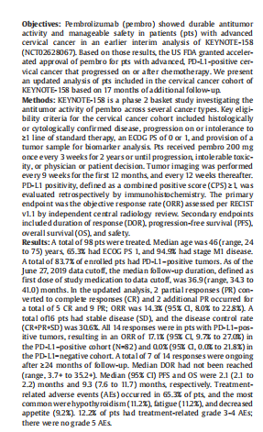
KEYNOTE 158: Pembrolizumab as Monotherapy in ≥2L
PD-L1–positive CC: ORR up to 17.1%
Pembrolizumab demonstrated durable antitumor activity in 98 patients with CC who progression on or intolerance to ≥1L of standard therapy, A total of 83.7% of enrolled pts had PD-L1–positive tumors
In the updated analysis, ORR was 14.3%,DOR was 30.6%.
All 14 responses were in pts with PD-L1–positive tumors, resulting in an ORR of 17.1% in the PD-L1–positive cohort (N=82) and 0.0% in the PD-L1−negative cohort.
A total of 7 of 14 responses were ongoing after ≥24 months of follow-up.
TRAEs occurred in 65.3% of pts
With 17 months of additional follow-up, Pembrolizumab continues to show durable antitumor activity and manageable safety in patients with advanced CC, similar to the previous report.
Chung, HC. et al. Gynecol Oncol, 2021,162(Supplement 1):S27.

Slide 20
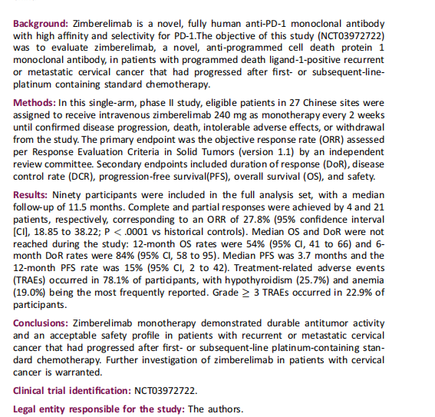
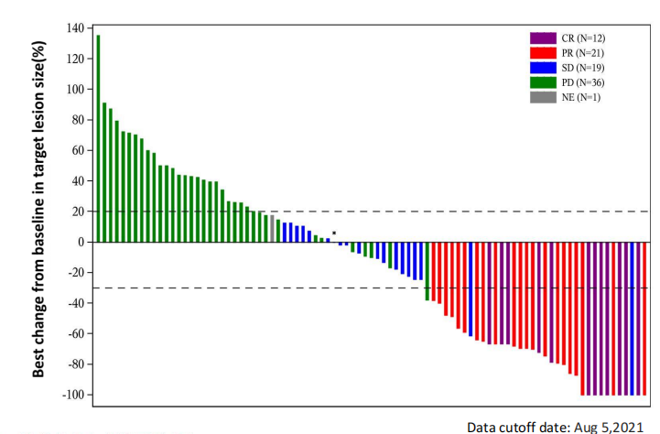
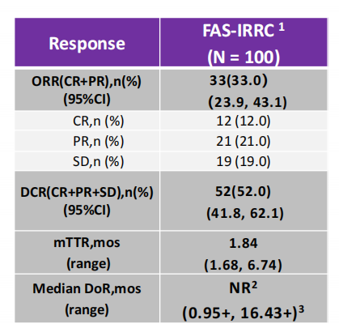
Cadonilimab or Zimberelimab Monotherapy in ≥2L R/M CC:
ORR up to 33% and 27.8%, respectively
Cadonilimab Monotherapy in ≥2L R/M CC
(NCT03852251)
Zimberelimab Monotherapy in ≥2L PD-L1-positive R/M CC (NCT03972722)
ORR in 100 eligible pts was 33.0%
The median follow-up of 11.5 months
The ORR was 27.8%
Median OS and DoR were not reached during the study: 12-month OS rates were 54% and 6-month DoR rates were 84%
Median PFS was 3.7 months and the 12-month PFS rate was 15%
TRAEs occurred in 78.1% of participants,
Grade≥3 TRAEs occurred in 22.9% of participants.
Results
Response | FAS-IRRC¹ (N=100)
ORR(CR+PR),n(%) (95%CI) | 33(33.0) (23.9,43.1)
CR,n(%) | 12(12.0)
PR,n (%) | 21(21.0)
SD,n (%) | 19 (19.0)
DCR(CR+PR+SD),n(%) (95%CI) | 52(52.0) (41.8,62.1)
mTTR, mos (range) | 1.84 (1.68,6.74)
Median DoR, mos (range) | NR² (0.95+,16.43+)³
Conclusions:
Zimberelimab monotherapy demonstrated durable antitumor activity and an acceptable safety profile in patients with recurrent or metastatic cervical cancer that had progressed after first- or subsequent-line platinum-containing standard chemotherapy. Further investigation of zimberelimab in patients with cervical cancer is warranted.
IRRC: Independent radiological review committee; NR=Not Reached;Represents deletion (no disease progression or death)
2022 SGO AK104-201(NCT04380805)
2022 ESMO IO Abs 79P.

Slide 21
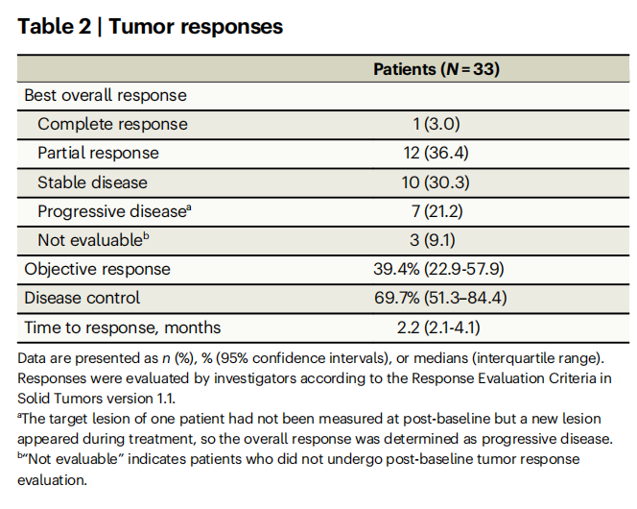
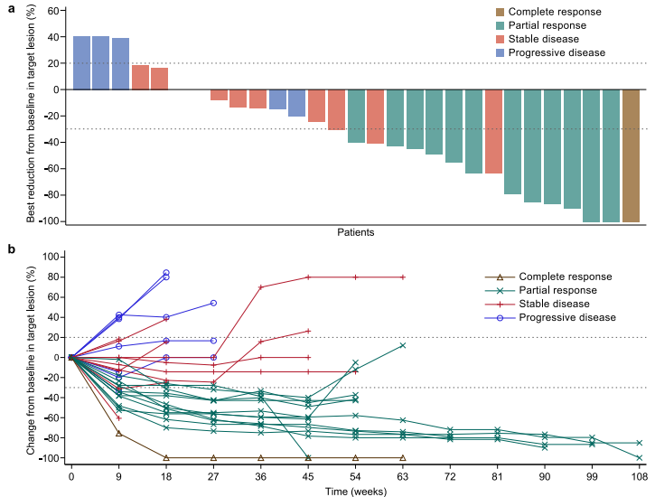
Camrelizumab plus famitinib in ≥2L R/M CC : ORR up to 39.4%
This phase 2 study assesses the efficacy and safety of camrelizumab (an anti-PD-1 antibody) plus famitinib (anti-angiogenic agent) in women with pretreated recurrent or metastatic cervical cancer
Eligible patients receive camrelizumab 200 mg intravenously on day 1 of each 3-week cycle plus famitinib 20 mg orally once daily
 | Patients N=33
Best overall response, n (%)
Complete response | 1 (3.0)
Partial response | 12 (36.4)
Stable disease | 10 (30.3)
Progressive diseaseª | 7 (21.2)
Not evaluable^{b} | 3 (9.1)
Objective response | 39.4% (22.9-57.9)
Disease control | 69.7% (51.3–84.4)
Time to response, months | 2.2 (2.1-4.1)
Tumor responses after camrelizumab plus famitinib treatment.
Waterfall plot demonstrating the best percentage change from baseline in target tumor lesion size.
Spider plot presenting the percentage change from baseline in target tumor lesion size over time.
ªThe target lesion of one patient had not been measured at post-baseline but a new lesion appeared during treatment, so the overall response was determined as progressive disease.
^{b}“Not evaluable” indicates patients who did not undergo post-baseline tumor response evaluation.
The camrelizumab with famitinib combination appeared to show antitumor activity in ≥2L R/M CC with an acceptable safety profile.
This combination may represent a treatment option for this population.
Xia L, et al. Nat Commun. 2022;13(1)_7581.

Slide 22
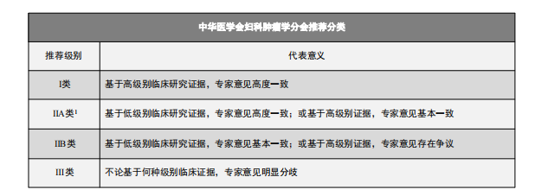
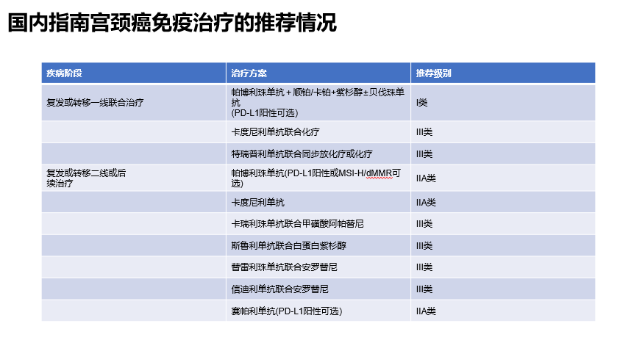
Recommendations of Chinese Guideline on IO for CC
Disease Phase | Regimens | Recommendations
1L R/M CC | Pembrolizumab + cisplatin/carboplatin + paclitaxel ± bevacizumab (optional for PD-L1 positive) | I
 | Cadonilimab + chemotherapy | III
 | Toripalimab + concurrent chemoradiotherapy/chemotherapy | III
≥2L R/M CC | Pembrolizumab (optional for PD-L1 positive or MSI-H/dMMR) | IIA
 | Cadonilimab | IIA
 | Camrelizumab + apatinib | III
 | Serplulimab + albumin paclitaxel | III
 | Tislelizumab + anlotinib | III
 | Sintilimab + anlotinib | III
 | Zimberelimab (optional for PD-L1 positive) | IIA
中国妇科肿瘤临床实践指南第7版 (2023)

Slide 23
Cervical Cancer: Breakthrough in all lines
  LACC
  1L CC
  ≥2L CC
  Endometrial Cancer: Precision and IO combinations
  Newly diagnosed EC
  FPST(following prior systemic therapy) EC
  Ovarian Cancer: IO combinations
  1L maintenance OC
  PROC
Contents
LACC, locally advanced cervical cancer

Slide 24
IO landscape in EC in China
Drug | Newly diagnosed, adjuvant | Newly diagnosed, 1L | FPST, MSI-H/dMMR | FPST, MSS/pMMR
Pembrolizumab | Ongoing:Ph3 KEYNOTE-B21 (Pembro+Chemo) | Ph3 NRG-GY018 (CRT±Pembro) Ongoing:Ph3 KEYNOTE-C93 (Pembro) Ongoing:Ph3 LEAP-001 (Pembro+Lenva) | Ph2 KEYNOTE-158 (Pembro alone) | Ph3 KEYNOTE-775 (Lenva+Pembro)
Tislelizumab | Ongoing:Ph1b/2 NCT04577963 (Fruquintinib+Tislelizumab) | - | Ph2 NCT03736889 (Tislelizumab alone) | -
Sintilimab | Ongoing:Ph1b/2 NCT03903705 (Fruquintinib+Sintilimab) | - | Ph2(Sintilimab + Anlotinib)
Serplulimab | - | - | Ph2 NCT03941574 (Serplulimab alone) | -
Envafolimab | - | - | - | Ongoing: Ph2 NCT05112991 (Envafolimab±Lenva)
FPST(following prior systemic therapy)
Ramez N. Eskander, et al. 2023 SGO Oral 264
O'Malley DM, et al. J Clin Oncol. 2022;40(7)_752-761
Makker V, et al. J Clin Oncol. 2023;41(16):2904-2910
2022 SGO 127
2023 ASCO Abstract 5598
2022 ASCO Abs 2592.
Slomovitz et. Presented at 2022 ASCO.
Marth C et al. Int J Gynecol Cancer. 2022 Jan;32(1):93-100. Epub 2021 Nov 19.
clinicaltrials.gov/ct2/show/NCT04634877. Accessed 26 January 2021.
https://classic.clinicaltrials.gov/ct2/show/NCT05112991
https://classic.clinicaltrials.gov/ct2/show/NCT04577963
https://classic.clinicaltrials.gov/ct2/show/NCT03903705

Slide 25
IO trials with results in EC
Drugs | Pembrolizumab |  |  | Tislelizumab | Sintilimab | Serplulimab
Company
MoA | Anti-PD-1 |  |  | Anti-PD-1 | Anti-PD-1 | Anti-PD-1
Patients | 1L Advanced EC | ≥2L MSI-H/dMMR advanced EC | ≥2L MSS/pMMR advanced EC | ≥2L MSI-H/dMMR advanced solid tumors | ≥2L EC | ≥2L MSI-H/dMMR solid tumors
Treatment | Chemoradiotherapy ± Pembrolizumab | Pembrolizumab alone | Lenvatinib + Pembrolizumab | Tislelizumab alone | Sintilimab + Anlotinib | Serplulimab
Study | NRG-GY018 | KEYNOTE 158 | KEYNOTE-775 | NCT03736889 | - | NCT03941574
Phase | III | II | III | II | II | II
Approval in China | - | - | - | √ | - | √
Primary Endpoint | PFS | ORR | PFS;OS | ORR | ORR | ORR
EC, endometrial cancer
Ramez N. Eskander, et al. 2023 SGO Oral 264
O'Malley DM, et al. J Clin Oncol. 2022;40(7)_752-761
Makker V, et al. J Clin Oncol. 2023;41(16):2904-2910
2022 SGO 127
2023 ASCO Abstract 5598
2022 ASCO Abs 2592.

Slide 26
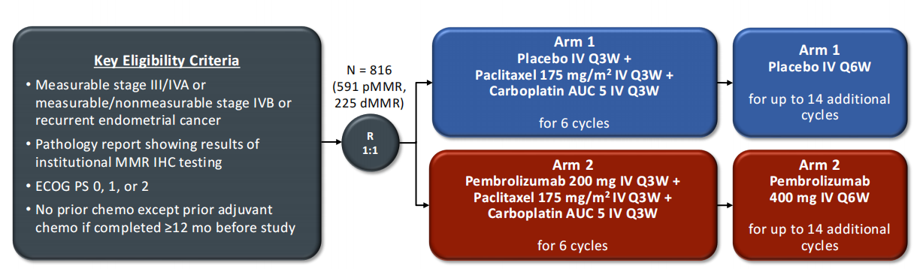
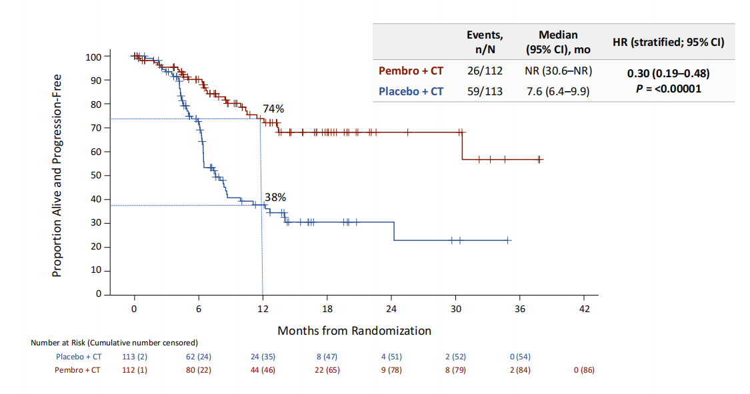
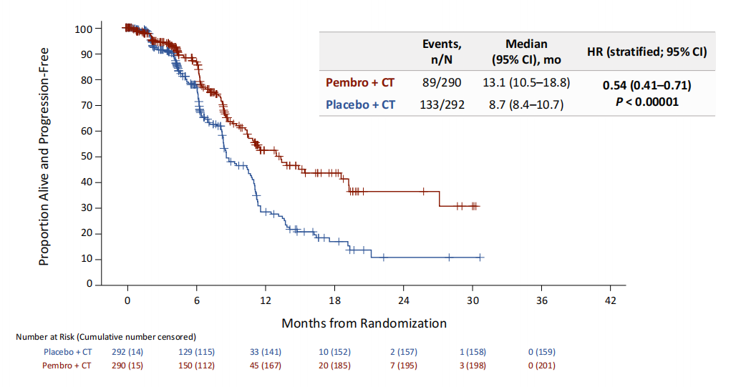
IO + chemo: 1L Pembrolizumab + chemotherapy for All-comers
NRG-GY018：Pembrolizumab + chemotherapy for 1L treatment of advanced EC met primary endpoint
Key eligibility criteria
Arm 1
Placebo IV Q3W +
Paclitaxel 175 mg/m² IV Q3W +
Carboplatin AUC 5 IV Q3W
for 6 cycles
Arm 1
Placebo IV Q6W
for up to
14 additional cycles
Endpoints
Primary: PFS per RECIST v1.1 by investigator in pMMR and dMMR populations
Secondary: Safety, ORR/DOR per RECIST v1.1 by BICR or investigator by treatment arm and MMR IHC status, OS in pMMR and dMMR populations, PRO/QoL in pMMR population, and concordance of institutional vs central MMR IHC testing results
Measurable stage III/IVA or measurable/ non-measurable stage IVB or recurrent endometrial cancer
Pathology report showing results of institutional MMR IHC testing
ECOG PS 0, 1, or 2
No prior chemo except prior adjuvant chemo if completed ≥12 mo before study
N = 816
(591 pMMR,
225 dMMR)
R
1:1
Arm 2
Pembrolizumab 200 mg IV Q3W +
Paclitaxel 175 mg/m2 IV Q3W +
Carboplatin AUC 5 IV Q3W
for 6 cycles
Arm 2
Pembrolizumab
400 mg IV Q6W
for up to
14 additional cycles
Stratification Factors
dMMR vs pMMR
ECOG PS (0 or 1 vs 2)
Prior adjuvant chemo (yes vs no)
PFS per RECIST v1.1: dMMR Population
PFS per RECIST v1.1: pMMR Population
Ramez N. Eskander, et al. 2023 SGO Oral 264

Slide 27
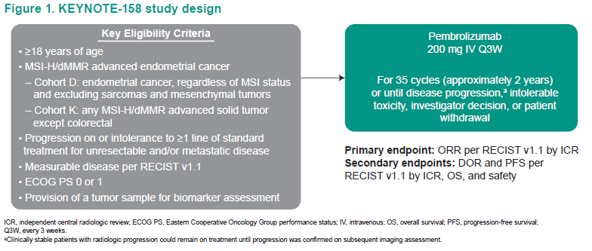
KEYNOTE 158 cohort D&K: Pembrolizumab in ≥2L EC
An non-randomised, open-label, multicohort, phase II KEYNOTE-158 study of pembrolizumab in multiple types of advanced rare cancers, recently reports efficacy and safety data in a larger number of patients with longer follow-up among patients with ≥2L MSI-H/dMMR EC
Key eligibility criteria
≥18 years of age
MSI-H/dMMR advanced EC
  Cohort D: EC, regardless of MSI status and excluding sarcomas and mesenchymal tumors
  Cohort K: any MSI-H/dMMR advanced solid tumor except colorectal
Progression on or intolerance to >1 line of standard treatment for unresectable and/or metastatic disease
Measurable disease per RECIST v1.1
ECOG PS 0 or 1
Provision of a tumor sample for biomarker assessment
Pembrolizumab
200 mg IV Q3W
For 35 cycles (approximately 2 years) or until disease progression,* intolerable toxicity, investigator decision, or patient withdrawal
Primary endpoint: ORR per RECIST v1.1 by ICR
Secondary endpoints: DOR and PFS per RECIST v1.1 by ICR, OS, and safety
*Clinically stable patents with radiologic progression could remain on treatment until progresson was confirmed on subsequent imaging assessment.
ICR, independent central radiologic review; ECOG PS, Eastern Cooperatve Oncotagy Group performance status; IV, intravenous; OS, overell survival; PFS, progression-free survival. Q3W. every 3 weeks.
D.M. O’Malley, et al. 2022 ESMO. 546P

Slide 28
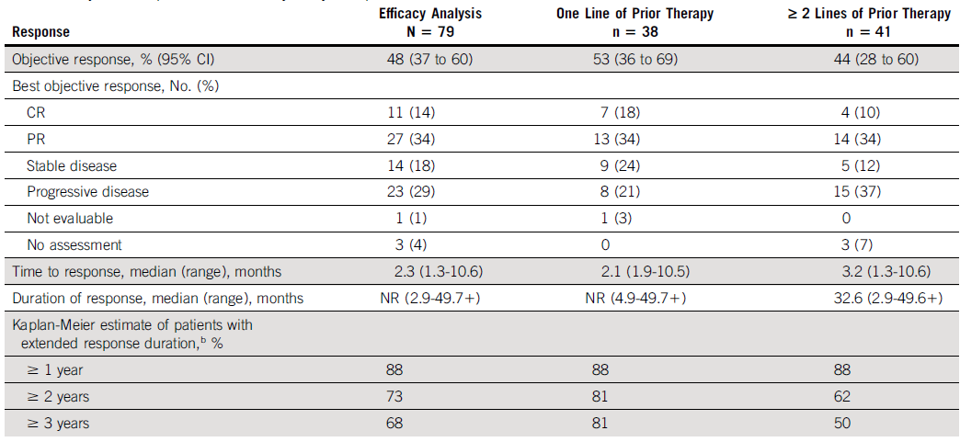
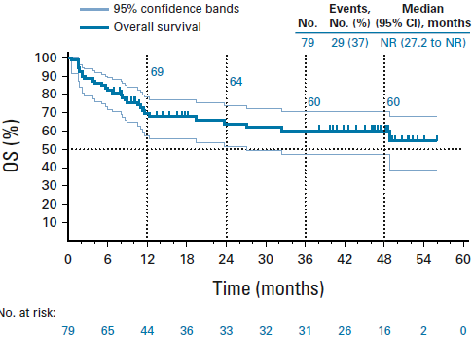
Pembrolizumab monotherapy in ≥2L MSI-H/dMMR EC:
4-year OS rate 60%
KEYNOTE-158 shows,18 of 90 treated patients (20%) had completed 35 cycles of pembrolizumab and 52 (58%) had discontinued treatment. In the efficacy population (N=79), the median time from first dose to data cutoff was 42.6 months
The objective response rate was 48%，PFS rate was 37%，OS rate was 60% at 4 years
Response | Efficacy Analysis N=79 | 1L Prior Therapy N=38 | ≥2 L Prior Therapy N=41
ORR, % (95% CI) | 48 (37 - 60) | 53 (36 - 69) | 44 (28 - 60)
Best objective response, No. (%)
CR | 11 (14) | 7 (18) | 4 (10)
PR | 27 (34) | 13 (34) | 14 (34)
Stable disease | 14 (18) | 9 (24) | 5 (12)
Progressive disease | 23 (29) | 8 (21) | 15 (37)
Not evaluable | 1 (1) | 1 (3) | 0
No assessment | 3 (4) | 0 | 3 (7)
Time to response, median (range), months | 2.3 (1.3-10.6) | 2.1 (1.9-10.5) | 3.2 (1.3-10.6)
Duration of response, median (range), months | NR (2.9-49.71) | NR (4.9-49.71) | 32.6 (2.9-49.61)
Kaplan-Meier estimate of patients with extended response duration, %
≥ 1 year | 88 | 88 | 88
≥ 2 years | 73 | 81 | 62
≥ 3 years | 68 | 81 | 50
O'Malley DM, et al. J Clin Oncol. 2022;40(7)_752-761

Slide 29
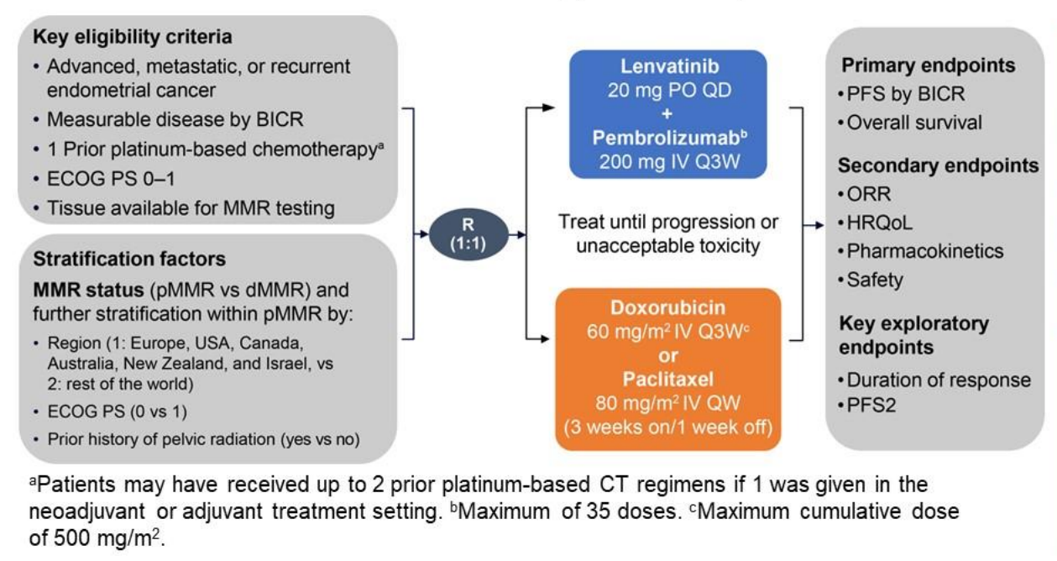
KEYNOTE-775: Lenvatinib + Pembrolizumab in ≥2L EC
Study 309/KEYNOTE-775 was a multicenter, open-label, randomized, phase 3 trial enrolling patients with advanced EC following systemic platinum-based treatment to receive lenvatinib + pembrolizumab or treatment of physician's choice
Key eligibility criteria
Lenvatinib
20 mg PO QD
+
Pembrolizumab^{b}
200 mg IV Q3W
Advanced, R/M EC
Measurable disease by BICR
1 Prior platinum-based chemotherapyª
ECOG PS 0-1
Tissue available for MMR testing
Primary endpoints
• PFS by BICR
• Overall survival
Secondary endpoints
• ORR
• HRQoL
Pharmacokinetics
• Safety
R
1:1
Treat until progression or unacceptable toxicity
Stratification factors
MMR status (pMMR vs dMMR) and further stratification within pMMR by:
Region (1: Europe, USA, Canada, Australia, New Zealand, and Israel, vs 2: rest of the world)
ECOG PS (0vs1)
Prior history of pelvic radiation (yes vs no)
Doxorubicin
60 mg/m² IV Q3W^{C}
or Paclitaxel
80 mg/m² IV QW
(3 weeks on/1 week off)
Key exploratory endpoints
• Duration of response
• PFS2
ªPatients may have received up to 2 prior platinum-based CT regimens if 1 was given in the neoadjuvant or adjuvant treatment setting. ^{b}Maximum of 35 doses. ^{c}Maximum cumulative dose of 500 mg/m².
Vicky Makker, et al. 2022 ASCO No.5587

Slide 30
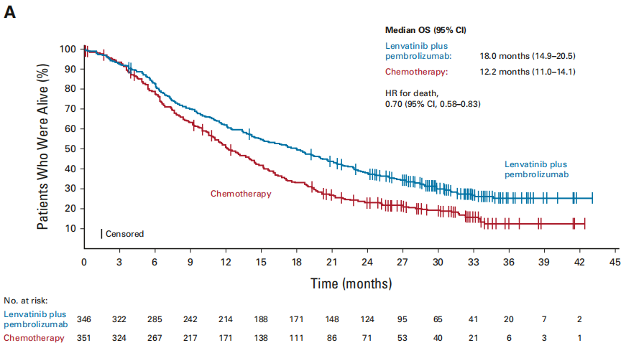
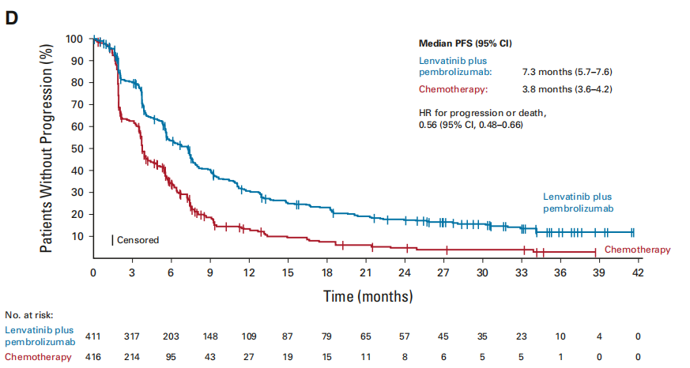
KEYNOTE-775: Lenvatinib + Pembrolizumab vs. Chemotherapy in pMMR population: mOS 18.0 vs. 12.2 months
pMMR
Full-set
Lenvatinib plus pembrolizumab showed benefits in OS, PFS (pMMR HR, 0.60; 95% CI, 0.50 to 0.72; all-comer HR, 0.56; 95% CI, 0.48 to 0.66), and ORR (pMMR patients, 32.4% v 15.1%; all-comers, 33.8% v 14.7%) versus chemotherapy.
No new safety signals were observed.
Lenvatinib plus pembrolizumab continued to show improved efficacy versus chemotherapy and manageable safety in patients with previously treated advanced EC
Makker V, et al. J Clin Oncol. 2023;41(16):2904-2910

Slide 31
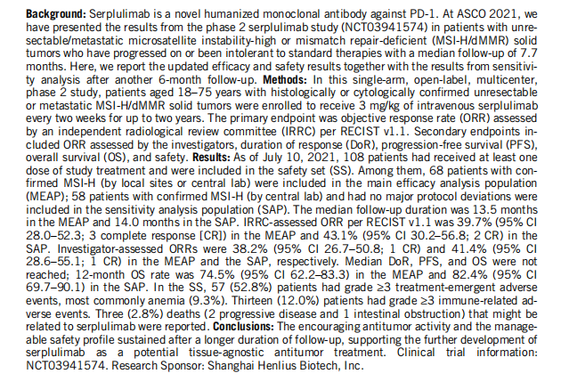
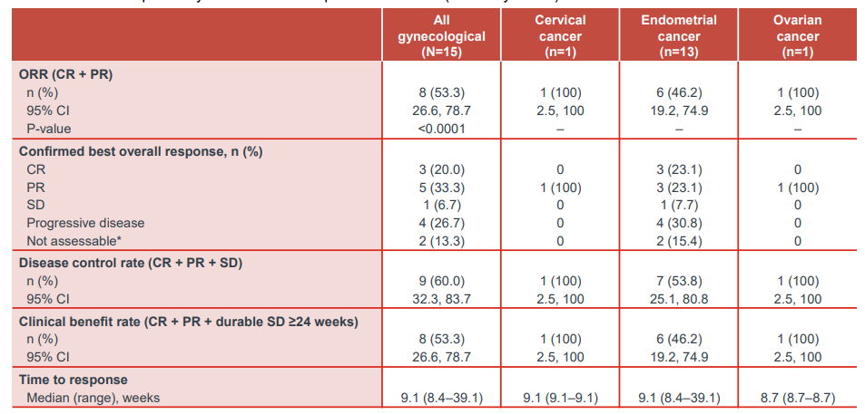
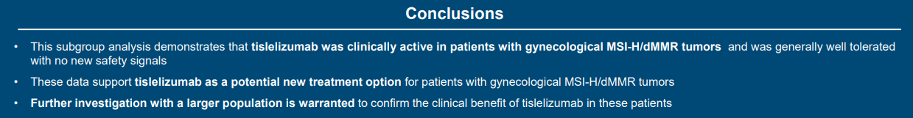
Tislelizumab or Serplulimab monotherapy in ≥2L MSI-H/dMMR solid tumors: ORR up to 53.3% and 39.7%, respectively
Tislelizumab monotherapy in ≥2L MSI-H/dMMR solid tumors
(RATIONALE 209)
Serplulimab monotherapy in ≥2L MSI-H/dMMR solid tumors
(NCT03941574)
 | All gynecological (N=15) | Cervical cancer (n=1) | Endometrial cancer (n=13) | Ovarian cancer (n=1)
ORR (CR + PR) n (%) 95% Cl P-value | 8 (53.3) 26.6, 78.7 <0.0001 | 1 (100) 2.5, 100 - | 6 (46.2) 19.2, 74.9 - | 1 (100) 2.5, 100 -
Confirmed best overall response, n (%) CR PR SD Progressive disease Not assessable* | 3 (20.0) 5 (33.3) 1 (6.7) 4 (26.7) 2(13.3) | 0 1 (100) 0 0 0 | 3(23.1) 3(23.1) 1 (7.7) 4 (30.8) 2(15.4) | 0 1 (100) 0 0 0
Disease control rate (CR+PR+SD) n (%) 95% Cl | 9 (60.0) 32.3, 83.7 | 1 (100) 2.5, 100 | 7 (53.8) 25.1,80.8 | 1 (100) 2.5, 100
Clinical benefit rate (CR+PR+durable SD >24 weeks) n (%) 95% Cl | 8 (53.3) 26.6, 78.7 | 1 (100) 2.5, 100 | 6 (46.2) 19.2, 74.9 | 1 (100) 2.5, 100
Time to response Median (range), weeks | 9.1 (8.4-39.1) | 9.1 (9.1-9.1) | 9.1 (8.4-39.1) | 8.7 (8.7-8.7)
Results | MEAP (N=68) | SAP (N=58)
ORR,%(95%CI) | 39.7(28.0,52.3) | 43.1(30.2,56.8)
DCR,%(95%CI) | 67.6(55.2,78.5) | 72.4(59.1,83.3)
CR,n(%) | 3(4.4) | 2(3.4)
PR,n(%) | 24(35.3) | 23(39.7)
SD,n(%) | 19(27.9) | 17(29.3)
PD,n(%) | 18(26.5) | 13(22.4)
NE,n(%) | 4(5.9) | 3(5.2)
Conclusions: The encouraging antitumor activity and the manageable safety profile sustained after a longer duration of follow-up, supporting the further development of serplulimab as a potential tissue-agnostic antitumor treatment.
This subgroup analysis demonstrates that tislelizumab was clinically active in patients with gynecological MSI-H/dMMR tumors and was generally well tolerated with no new safety signals.
MEAP,main efficacy analysis population; SAP, sensitivity analysis population
2022 SGO 127
2022 ASCO Abs 2592.

Slide 32
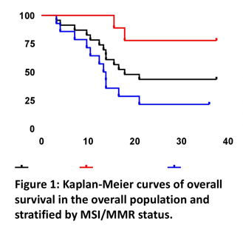
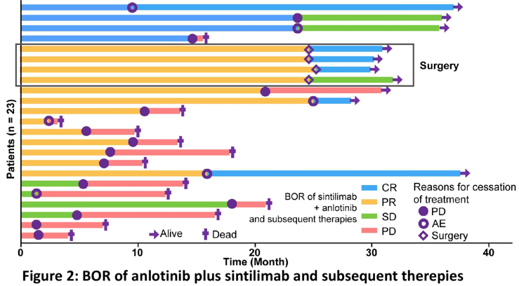
Sintilimab + Anlotinib in ≥2L EC: ORR 73.9%, updated OS 17.8 months
ln the earlier phase ll study, Chinese patients with recurrent or advanced endometrial cancer treated with sintilimab plus anlotinib had an ORR of 73.9%, 2023 ASCO further updated OS and subsequent therapies for this study
DCO:Dec 15,2022
The median follow-up was 31.0 months.We observed a median OS of 17.8 months.Patients with MSI-H had superior OS than their counterparts (not available vs.13.3 months; HR 0.15,95% CI,0.33-0.70; P=0.006; Figure 1).
Notably five patients with PRs obtained pathological (n=3) or radiography (n=2) CRs during follow-up (Figure 2)
In terms of OS, sintilimab + anlotinib had promising therapeutic effects. Pathological CR was observed in patients with
long-lasting PR, thus exploratory surgery may be required in selected patients.
2023 ASCO Abstract 5598

Slide 33
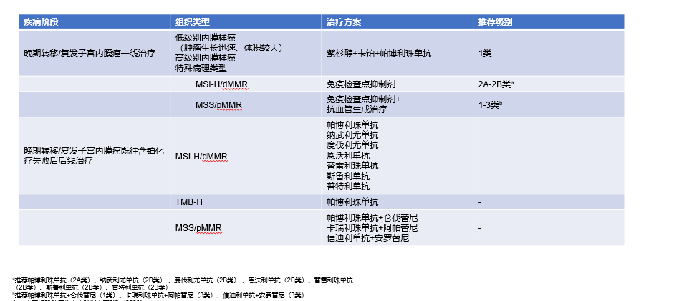
Recommendations of Chinese Guideline on IO for EC
Disease Phase | Histological type | Regimens | Recommendations
Advanced Recurrence or Metastasis 1L | Low grade endometrioid carcinoma High grade endometrioid carcinoma Special pathological types | Paclitaxel + carboplatin + pembrolizumab | I
 | MSI-H/dMMR | ICI | IIA-IIBª
 | MSS/pMMR | ICI + anti-angiogenesis therapy | I-III^{b}
Advanced Recurrence or Metastasis ≥2L, after failure of previous platinum-based chemotherapy | MSI-H/dMMR | Pembrolizumab Nivolumab Durvalumab Envafolimab Tislelizumab Serplulimab Pucotenlimab | -
 | TMB-H | Pembrolizumab | -
 | MSS/pMMR | Pembrolizumab + lenvatinib Camrelizumab + apatinib Sintilimab + anlotinib | -
ª Recommendations: Pembrolizumab (IIA)、Nivolumab (IIB) 、Durvalumab (IIB)、Envafolimab (IIB)、Tislelizumab (IIB)、Serplulimab (IIB)、Pucotenlimab (IIB)
^{b} Recommendations: Pembrolizumab + lenvatinib (I)、 Camrelizumab + apatinib (III)、 Sintilimab + anlotinib (III)
中国妇科肿瘤临床实践指南第7版 (2023)

Slide 34
Cervical Cancer: Breakthrough in all lines
  LACC
  1L CC
  ≥2L CC
  Endometrial Cancer: Precision and IO combinations
  Newly diagnosed EC
  FPST(following prior systemic therapy) EC
  Ovarian Cancer: IO combinations
  1L maintenance OC
  PROC
Contents
LACC, locally advanced cervical cancer

Slide 35
IO landscape in OC in China
Drug | 1L OC | PSR OC | PROC
Pembrolizumab | Ongoing: Ph3 KEYLYNK-001 (Pembro+Ola) | Ph2 OPEB-01 (Pembro+Bev＋Ola) | Ongoing: Ph3 KEYNOTE-B96 (Pembro+Paclitaxel±Bev)
Tislelizumab | Ongoing: Ph2 NCT04815408 (Tislelizumab＋NACT) | - | Ongoing: Ph2 BRIGHT (Tislelizumab+Bev+Nab-paclitaxel)
Toripalimab | Ongoing: Ph2a NCT05342506 (Toripalimab+ScTIL) | - | -
Durvalumab | Ph3 DUO-O (Chemo+Bev±Durva±Ola) | - | -
Camrelizumab | - | - | Ph2 NCT03827837 (Camrelizumab+Famitinib)
FPST,following prior systemic therapy; ScTIL, Genetically Modified Tumor Infiltrating Lymphocytes
2023 ASCO 5584
Philipp Harter, et al. 2023 ASCO No.5506.
Xia L, et al. J Immunother Cancer. 2022;10(1):e003831
https://classic.clinicaltrials.gov/ct2/show/NCT05044871?term=Tislelizumab&cond=ovarian+cancer&cntry=CN&draw=2&rank=1
https://classic.clinicaltrials.gov/ct2/show/NCT04815408?term=Tislelizumab&cond=ovarian+cancer&cntry=CN&draw=2&rank=2
https://classic.clinicaltrials.gov/ct2/show/NCT05342506?term=Toripalimab&cond=ovarian+cancer&draw=2&rank=1
Vergote et al. Presented at ASCO 2019; abstract TPS5603；
Colombo N, et al. 2022 ASCO Abstract. TPS5617.

Slide 36

IO trials with results in OC
Drugs | Pembrolizumab | Durvalumab | Camrelizumab
Company
MoA | Anti-PD-1 | Anti-PD-L1 | Anti-PD-1
Patients | ≥2L PSR OC | 1L OC | ≥2L PROC
Treatment | Pembrolizumab + bevacizumab ＋ olaparib | Chemotherapy + bevacizumab ± durvalumab ± olaparib | Camrelizumab + Famitinib
Study | OPEB-01 | DUO-O | NCT03827837
Phase | II | III | II
Approval in China | - | - | -
Primary Endpoint | PFS | PFS | ORR
OC, ovarian cancer; PROC, Platinum-resistant recurrent ovarian cancer; PSR, platinum-sensitive recurrent
2023 ASCO 5584
Philipp Harter, et al. 2023 ASCO No.5506.
Xia L, et al. J Immunother Cancer. 2022;10(1):e003831

Slide 37
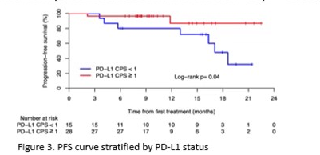
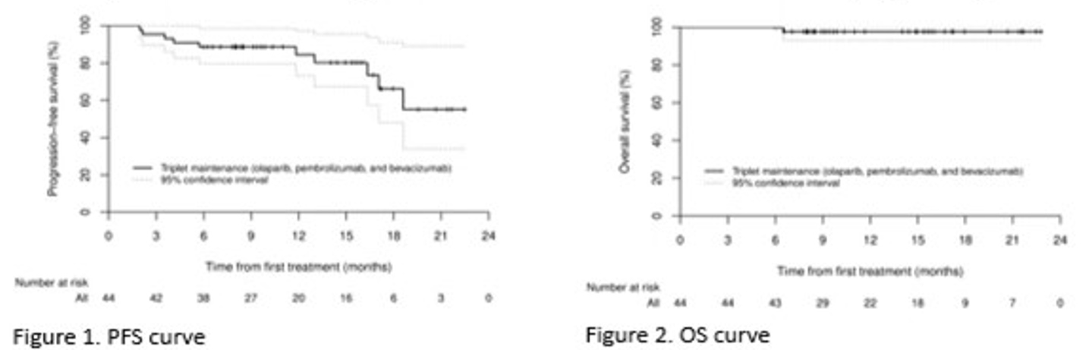
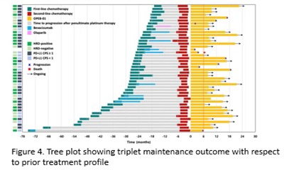
OPEB-01: Pembrolizumab + Bevacizumab + Olaparib in PSR OC:
6-months PFS rate was 88.6%
This study evaluated the efficacy and safety of triplet maintenance therapy (olaparib,bevacizumab,and pembrolizumab) in BRCA non-mutated patients with PSR OC
Forty-four patients were enrolled (median age 61 years), majority with high-grade serous carcinoma (93.2%) and partial response (75.0%) to 2L chemotherapy.
Overall,54.6% were HRD-positive(genomic instability score ≥42) and 63.6% had PD-L1 positive tumors(CPS≥1).
At 6 months, the PFS rate was 88.6%(95% Cl 75.4-96.2).The median PFS has not been reached (Figure 1). The 12-month PFS rate was 84.4%(95% Cl 73.2-97.4). The median OS was not reached (Figure 2)
The most common G3 TRAEs were anemia(20.5%)and neutropenia (6.8%), but there were no G4 AEs.
Exploratory analysis demonstrated remarkable survival outcomes regardless of HRD status, whereas patients with PD-L1 CPS≥1 showed improved PFS compared to those with PD-L1 CPS<1(P=0.032)(Figure 3).
Tree plot showing triplet maintenance therapy outcome, alongside with previous therapy duration, is shown in Figure 4.
Triplet maintenance in BRCA 1/2 non-mutated patients with PSR OC showed a promising outcome.
2023 ASCO 5584

Slide 38
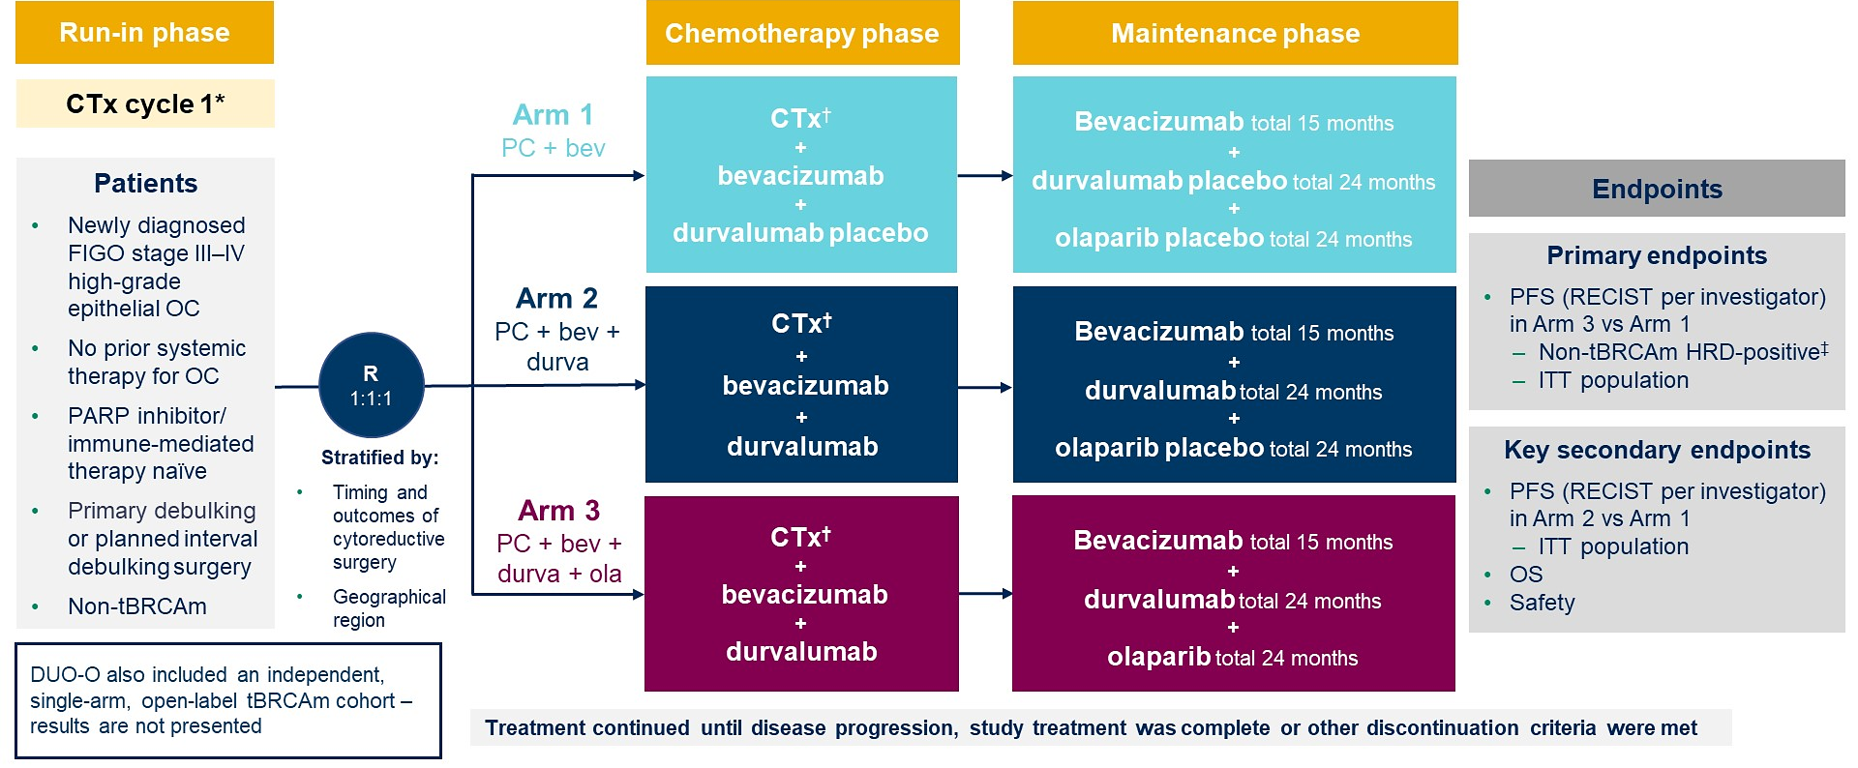
DUO-O：IO + PARPi + bevacizumab in 1L OC
The Phase llI DUO-O study evaluates paclitaxel/carboplatin + bevacizumab + durvalumab followed by maintenance therapy with bevacizumab + durvalumab + olaparib in patients with newly diagnosed non-tBRCAm advanced OC
化疗阶段
维持治疗阶段
Dosing and schedule: bevacizumab (15 mg/kg IV q3w); durvalumab (1120 mg V q3w); olaparib (300 mg po bid); chemotherapy. paclitaxel 175 mg/m² IV q3w and carboplatin at AUC5 or AUC6 IV q3w.PFS interim analysis
DCO:December 5,2022
*‘With or without bevacizumab according to local practice;†Cycles 2-6；‡ Genomic instability score ≥42 assessed prospectively by Myriad MyChoice CDx assay
Philipp Harter, et al. 2023 ASCO No.5506.

Slide 39
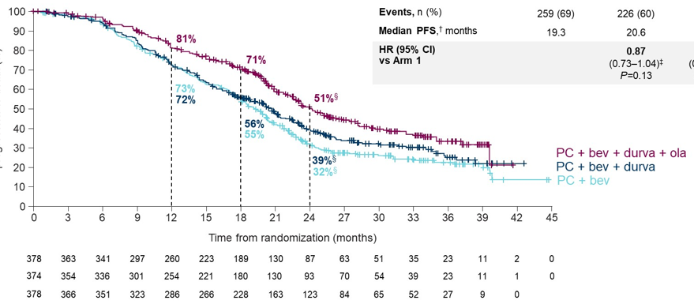
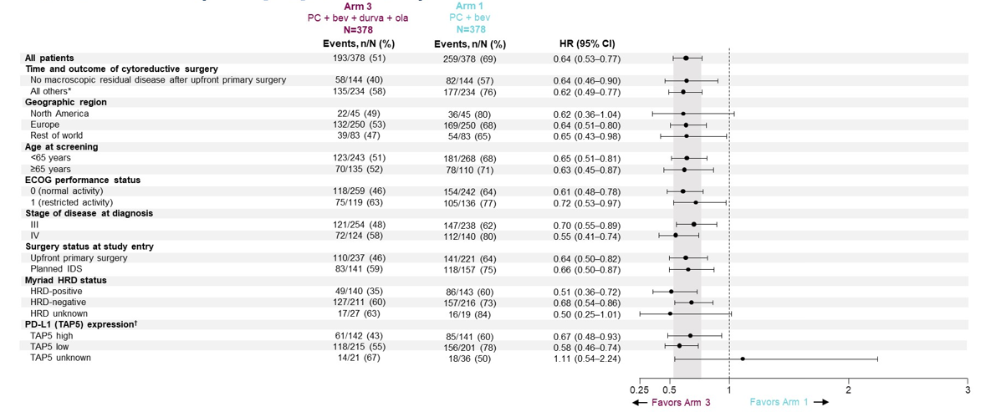
IO + PARPi + bevacizumab significantly prolonged PFS in ITT population: mPFS 24.2 months
 | Arm 1 PC+bev N=378 | Arm 2 PC+bev+durva N=374 | Arm 3 PC+bev+durva+ola N=378
Median PFS，†months | 19.3 | 20.6 | 24.2
HR (95% CI) vs Arm 1 |  | 0.87 (0.73-1.04)‡ P=0.13 | 0.63 (0.52-0.76)‡ P＜0.0001
Subgroup analyses of PFS
Arm 3 vs Arm 1 (ITT population)
PFS rate(%)
Patients at risk
Time from randomization (months)
Arm 1
Arm 2
Arm 3
*In censored patients; † Medians and rates were estimated by KM method; ‡HR and Cl were estimated from a stratified Cox proportional hazards model. Model stratified by timing and out come of cytoreductive surgery and geographical region. P value from a stratfied log rank text, §24-month PFS rates unstable.
Philipp Harter, et al. 2023 ASCO No.5506.

Slide 40


Camrelizumab plus famitinib in PROC: ORR up to 24.3%
This is an open-label, phase 2 basket study conducted in 25 medical centers in China, and the study design of this trial had been reported previously. Here, we present the data from the cohort 3 PROC.
All patients in this cohort received camrelizumab 200mg Q3W + famitinib 20mg QD until confirmed disease progression
Variables | All patients N=37
Best overall response, n (%)
Complete response | 0
Partial response | 9 (24.3)
Stable disease ≥6 weeks | 11 (29.7)
Progressive disease | 17 (45.9)
Not evaluable | 0
ORR, % (95% CI) | 24.3 (11.8 to 41.2)
DCR, % (95% CI) | 54.1 (36.9 to 70.5)
Time to response, months, median (range) | 2.1 (1.8 to 4.1)
Duration of response, months, median (95% CI) | 4.1 (1.9 to 6.3)
Progression-free survival, months, median (95% CI) | 4.1 (2.1 to 5.7)
Overall survival, months, median (95% CI) | 18.9 (10.8 to NR)
6-month rate (95% CI) | 89.2 (73.7 to 95.8)
9-month rate (95% CI) | 78.4 (61.4 to 88.5)
12-month rate (95% CI) | 67.2 (49.4 to 79.9)
The camrelizumab with famitinib combination appeared to show antitumor activity in ≥2L PROC with an acceptable safety profile.
This combination might provide a novel alternative treatment strategy in platinum-resistant ROC setting and warranted further exploration.
Xia L, et al. J Immunother Cancer. 2022;10(1):e003831

Slide 41

Recommendations of Chinese Guideline on IO for OC
Disease Phase | Histological type | Regimens | Recommendations
Primary | - | - | -
Recurrence | MSI-H/dMMR or TMB-H | Pembrolizumab | -
中国妇科肿瘤临床实践指南第7版 (2023)

Slide 42
Summary
Cervical cancer: Breakthrough in all lines
KEYNOTE-A18 obtained positive results, advancing to era of immunotherapy for LACC
Excellent data of IO + chemotherapy ± bevacizumab for 1L R/M CC
≥2L evidences of IO are sufficient
Endometrial cancer: Precision and IO combinations
Immune monotherapy for MSI-H/dMMR EC: long-term benefit
Immune combination therapy demonstrates synergistic effects
Ovarian cancer: IO combinations are under exploration
DUO-O positive results marks immune combination therapy with initial success in 1L treatment
IO combination therapy for PROC will break through and remains to be further investigated

Slide 43

Thanks for your attention
Fudan University Shanghai Cancer Center
Because of professionalism, we adhere to standards
because of standards, we lead the way

